Slide 1
Bubble entrapment owing to falling drops on a liquid surface Gautam Biswas J C Bose National Fellow Indian Institute of Technology Guwahati, Guwahati-781039

Slide 2



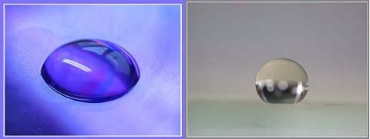
IMPACT OF LIQUID DROP ON LIQUID AND SOLID
SPLASHING
COALESCENCE
HYDROPHILIC
HYDROPHOBIC
Notes:
Drop impact is a common phenomenon we come across in daily life. Here are some pictures showing the outcome of drop impact on liquid and solid substrates.

Slide 3

Phenomena of liquid drop impact on liquid
Applications:
Spray cooling
Ink-jet printing
Atmospheric and oceanographic sciences investigate phenomena connected with rain formation and the interaction of rain with the surface of the ocean.

Slide 4
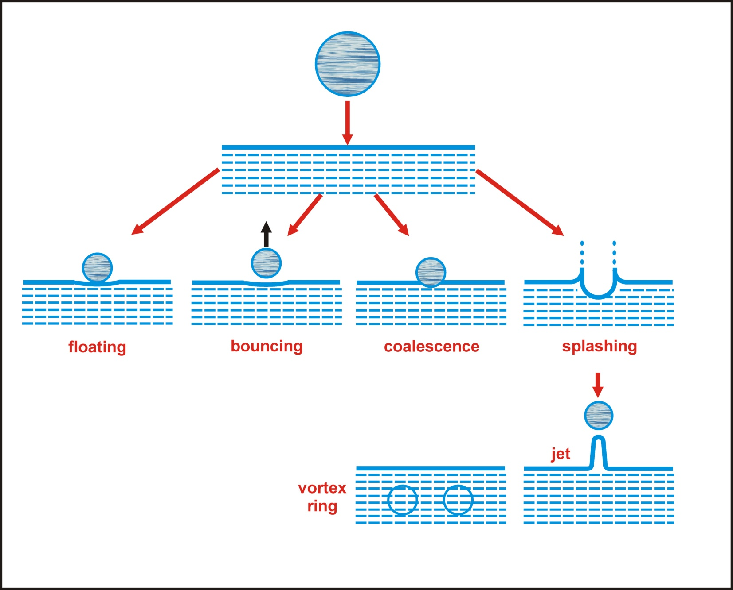
Impact of drop on liquid
Notes:
In literature, the types of phenomena when a liquid drop impacts on liquid surface are mainly: floating, bouncing, coalescence, splashing. Secondary drops are formed during splashing. With gradual increase in Weber number.

Slide 5
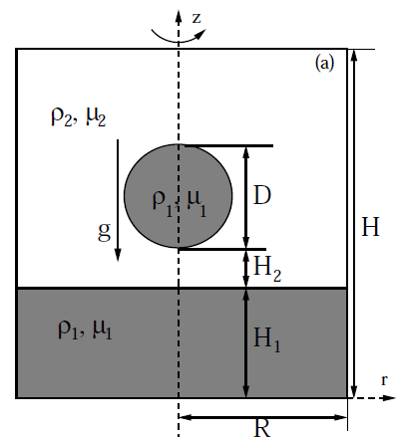
CLSVOF method
(Computational domain)
Nondimensional parameters
(liquid/liquid system):
Notes:
Four different parameters are used to determine the phenomena: Ohnesorge number for liquid 1, Ohnesorge number for liquid 2, Bond number, Atwood number.

Slide 6
Volume of Fluid (VOF) (Hirt and Nichols (1979)) The method tracks volume fraction of each fluid in cells that contains portions of the interface, rather then the interface itself. Variable: liquid void fraction, α = α = 0 gas α = 1 Liquid 0 < α < 1 A two phase cell
1
1
1
.68
0
1
1
1
.42
0
1
1
.92
.09
0
1
.85
.35
0
0
.31
.09
0
0
0
0
0
0
0
0

Slide 7
Volume of Fluid Continued… At each time step interface is reconstructed solving advection equation (geometrically) Update the void fractions for next time step Advantages Liquid - gas interface is captured explicitly Satisfies mass conservation Disadvantages Not very accurate for flows with high density differences

Slide 8
Level set (LS) (Osher and Sethian (1988)) Interface is represented by a smooth level set function Advantages The level set function varies smoothly across the interface: gives accurate curvature and interface normal vector. Disadvantages When interface is advected parallel, it gives accurate result. But for deforming interface there is mass loss.

Slide 9
Interface Construction SLIC (Simple Line Interface Method) Interface constructed using straight lines parallel to the coordinate axes 6 possible configuration Neighboring cells taken into account for flux determination Though crude, some reasonable predictions were made

Slide 10
Hirt and Nichols Interface is horizontal or Vertical (piecewise constant, stair stepped ) Derivatives of the void field determine whether the interface is horizontal or Vertical Derivatives calculated using fractional volumes averaged over several cells

Slide 11
Youngs Method (1982) or PLIC (Piecewise Linear Interface Construction) Interfaces - piecewise linear Interface has slope and is fitted within a single cell Interface slope and fluid position are determined from inspection of 8 neighboring cells

Slide 12
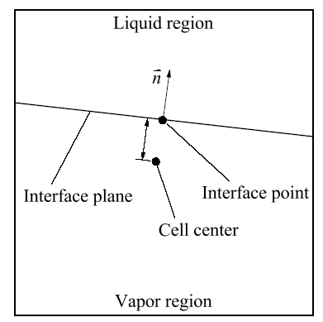
Youngs Method Continued… The interface is defined by the interface normal and length Position ( ) of the interface is so adjusted that it divides the cell into two areas which matches with the volume fraction completely locate the interface

Slide 13
LVIRA (Least Square Volume of Interface Reconstruction Algorithm, Puckett et al. (1997)) Properties: Piecewise linear approximation in each multifluid cell Orientation is optimized by the void fraction of the surrounding cells (3 x 3 block) by minimizing the function where is the given void fraction and is the approximation due to the linear interface Initial value of is taken from Young’s method Modify and till is minimized such that,

Slide 14
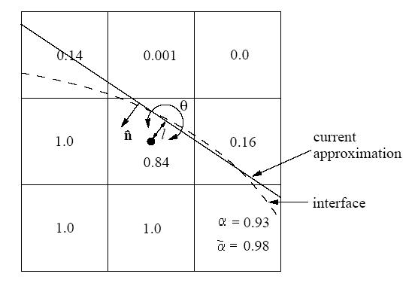

Slide 15
CLSVOF estimation of normal and curvature (Sussman et al. (2000)) Level Set function (Φ) is defined as: where d = d(r) is the shortest distance of a point r from the interface. Normal ‘n’ and curvature ‘κ’ are computed as:

Slide 16
CST Continued… Calculation of and One full augmented momentum equation can be written for all cells: ( liquid, gas and two-phase cells)

Slide 17
Surface Tension Model
The continuum surface force model (CSF) by Brackbill et al. is followed. The interfacial tension, represented as a volume force by the relation :
Dirac delta function (zero everywhere except at interface)
Surface tension force per unit interfacial area
normal component
Tangential component
(neglected since remains constant without temperature or concentration gradient)
this gives,
Using the Dirac delta function value ,
where is the characteristic color function defining each fluid involved, is
the interface normal vector .
Hence, the volume surface force is finally given by,

Slide 18
= surface tension force pet unit interfacial area = normal force + tangential force = Neglecting temperature or concentration change, surface tension constant so can be neglected. Modified momentum equation: Using the concept of diffusing the interface over a thin region according to Brackbill et al. [1992], J. Comput. Phys.

Slide 19
CST Continued… Heaviside function: An alternative to Kernal K₈ smoothening in CLSVOF. Smoothened density and viscosity field:

Slide 20
Solution Technique Staggered grid arrangement Uniform grid spacing FINITE DIFFERENCE discretization scheme Convective terms in momentum equation are discretized by ENO SCHEME. All other space derivatives are CENTRAL SCHEME. Pressure equation is solved by an iterative method based on preconditioned conjugate gradient BI-CGSTAB scheme. The numerical scheme is based on EXPLIXIT TIME ADVANCEMENT. Based on the velocity field at the new time step, a COULPED SECOND ORDER OPERATOR SPLIT ADVECTION SCHEME for discretization of the advection of void fraction (F) and level-set function ( ). The solution scheme is SECOND ORDER IN SPACE and FIRST ORDER IN TIME.

Slide 21
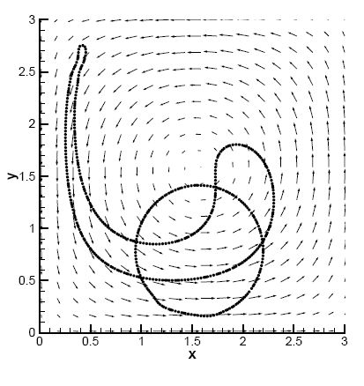
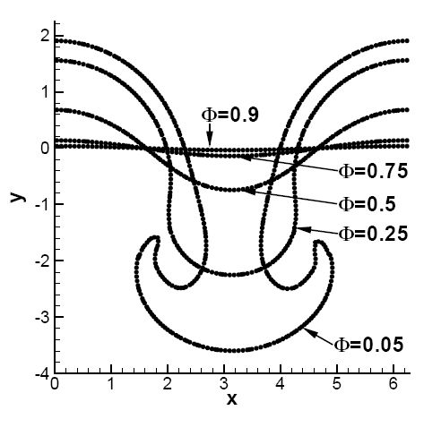
Code Validation
Advection Test | Surface tension Force

Slide 22
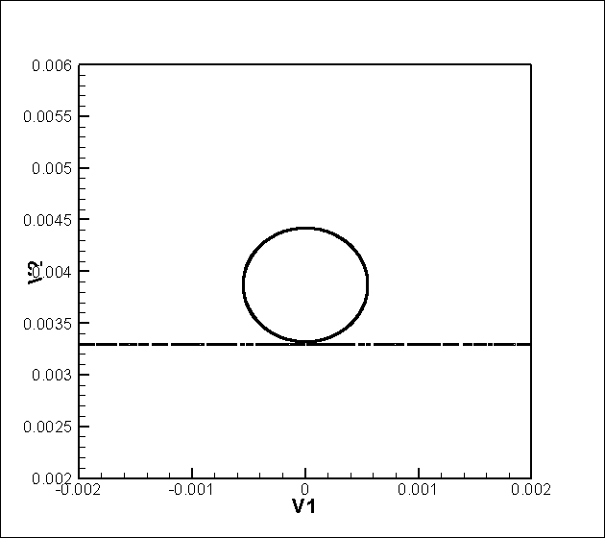
Secondary drops without splashing (animation)
Notes:
Animation of partial coalescence showing secondary and tertiary drops

Slide 23
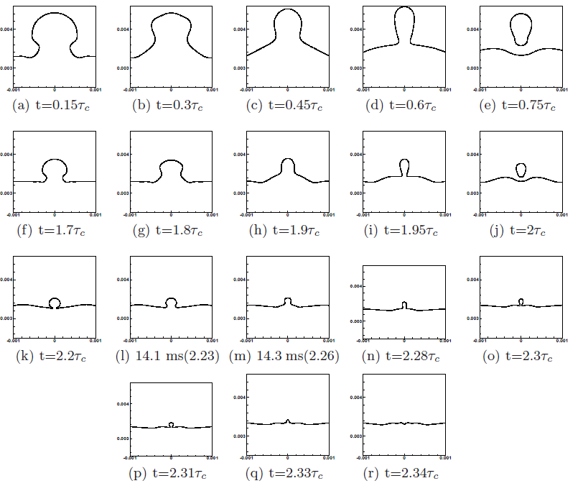
Coalescence cascade
Notes:
T= 0.75 Tc we observe first pinch off, At t = 2Tc we observe tertiary drop. The diameter ratios in the two steps are 0.54 and 0.47 respectively. The process of partial coalescence completes in a cascade of two steps. Kavehpour (2006) started with a drop of diameter 1.2 mm in water-air system and observed two steps in a cascade with secondary and tertiary diameters of 0.64 mm and 0.32 mm respectively.

Slide 24
Large drops cause complete coalescence
Notes:
For a high gravitational force, the value of Bond number increases. The thin film below the drop drains out slowly with time, finally creating a hole in the drop when it comes in contact with the interface at t=0.37 Tc, a small matrix drop, also called satellite drop, is seen to be trapped during the film rupture. Such an entrapment was observed by Thoroddsen et al (2008) and Chen et al (2006). The drop liquid was 18% PEO in water and the matrix liquid was decane. At t=0.52 Tc the drop completely drains into the bulk liquid leading to complete coalscence.

Slide 25
Different regimes
Notes:
Secondary to primary drop ratio xi has nearly constant value of 0.54. Secondary drop formed after the partial coalescence is nearly half the size of the initial drop. This region is named as inertio-capillary regime. For the other two regimes, the gravity dominant regime is named as the gravity regime and viscosity dominant regime is called as the viscous regime. In the gravity regime, there is a maximum drop-diameter Du at which the phenomena of partial coalescence is not observed. The drops equal to and larger than this particular diameter completely coalesce after impact. After the film ruptures, the larger drop drains off quickly into the bulk liquid due to more gravity. As the drop size is decreased, more resistance to capillary force is created and so gradually the secondary drop size becomes smaller. At a particular diameter DL the necking formed at the interface cannot be sustained and the drop completely coalesces. This is the minimum diameter below which the partial coalescence phenomenon is not observed.

Slide 26
Criteria for partial coalescence

Slide 27
Charles & Mason (1960) have suggested that the partial coalescence was due to a Rayleigh-Plateau instability.
Blanchette & Bigioni (2006) have argued that it is the convergence of the capillary waves on the drop apex which leads to secondary drop pinch off.

Slide 28
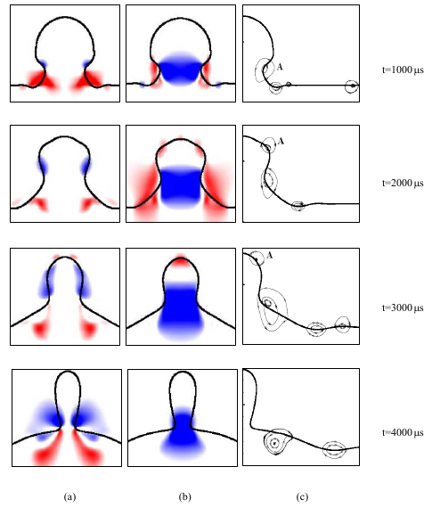
Horizontal velocity contour
(b) Vertical velocity contour
(c) Streamline
Red: positive value
Blue: negative value
Notes:
A capillary wave is a wave traveling along the phase boundary of a fluid, whose dynamics are dominated by the effects of surface tension. The results explain theory of Blanchette & Bigioni (2006). A represents caplllary wave which converges at the drop apex and give a vertical pull upwards leading to more horizontal momentum. This leads to pinch-off of secondary drop.

Slide 29
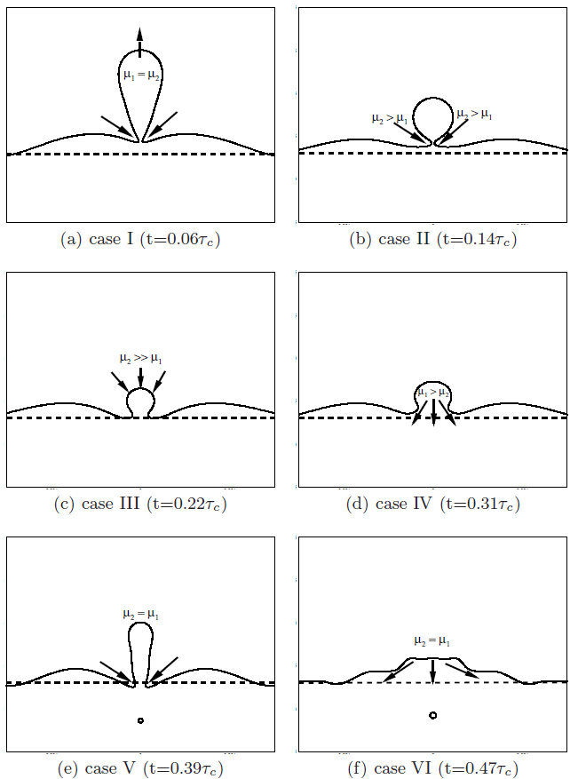
Notes:
Oh1=Oh2, the liquid column is stretched upwards to a long height. Liquid 2 forces inwards to do the pinch off. Bo is medium
Height of liquid column is lower due to the higher viscosity of liquid 2. Bo is medium
Oh1<< Oh2 (very high viscosity of liquid 2. pinch off is prevented and viscous liquid 2 pushes the drop to coalesce completely, Bo is medium
Oh1> Oh2. Due to high viscosity of liquid 1, the capillary waves are damped out and the drop coalesces completely. Bo is medium
Oh1 ~ Oh2, Bo > medium. Pinch off os secondary drop occurs.
Oh1~Oh2, Bo>> medium

Slide 30
From our study the important criterion for partial coalescence is the increasing horizontal momentum of the drop relative to the vertical momentum. This can be accomplished either by changing the viscosity or by changing the gravity within limits.

Slide 31
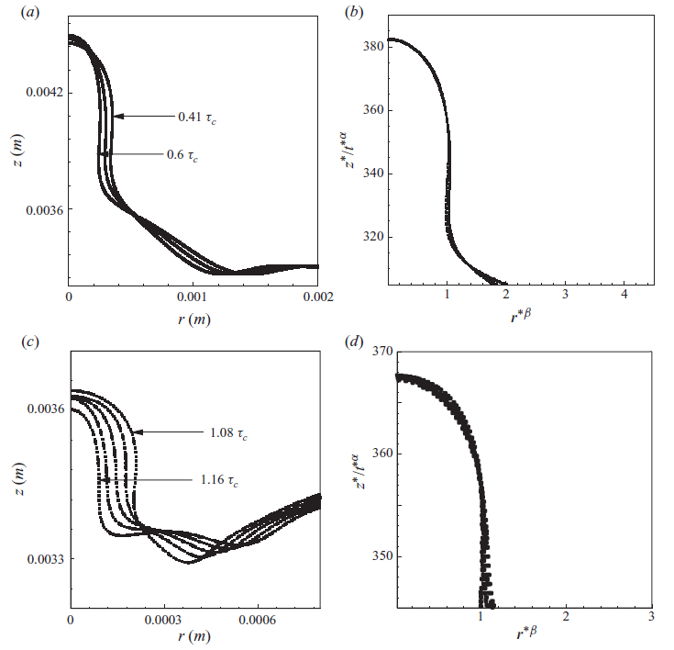
Self-similarity during column formation at TRANSITION ZONE
Acknowledge: Professor Stephane Zaleski of UPMC, Paris

Slide 32
A new bubble
entrapment zone

Slide 33
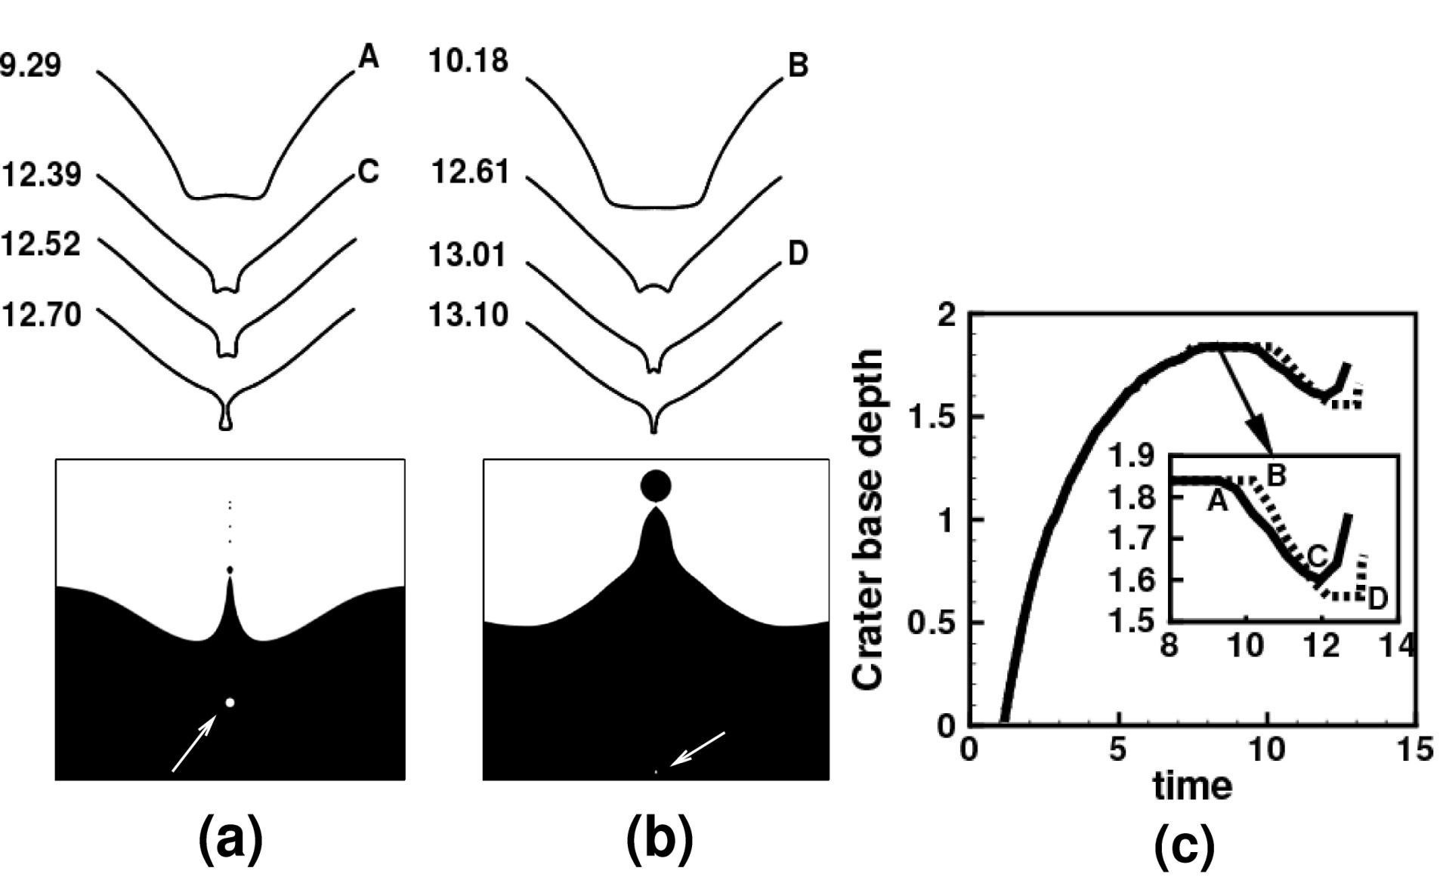
Different crater and jet shapes during large bubble entrapment (Fr =100,We =150) and small bubble entrapment (Fr=100,We= 160) phenomena.
Acknowledge: D. Morton, J. L. Liow and D. E. Cole of UNSW, Australia

Slide 34
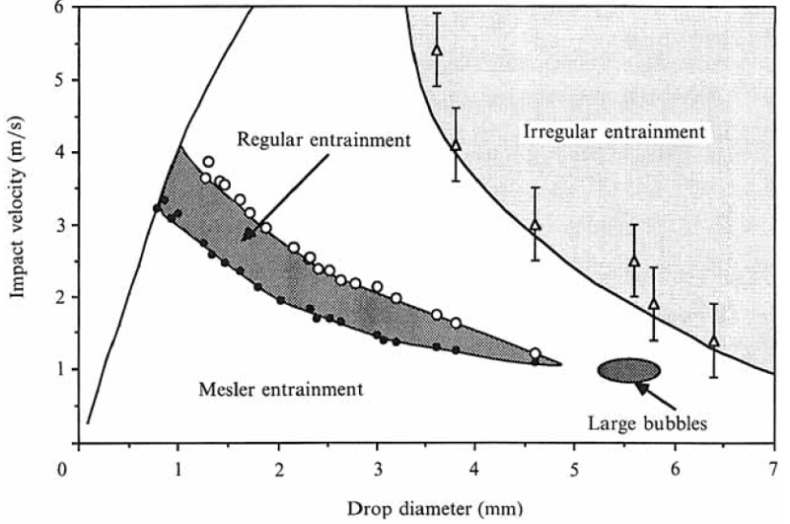
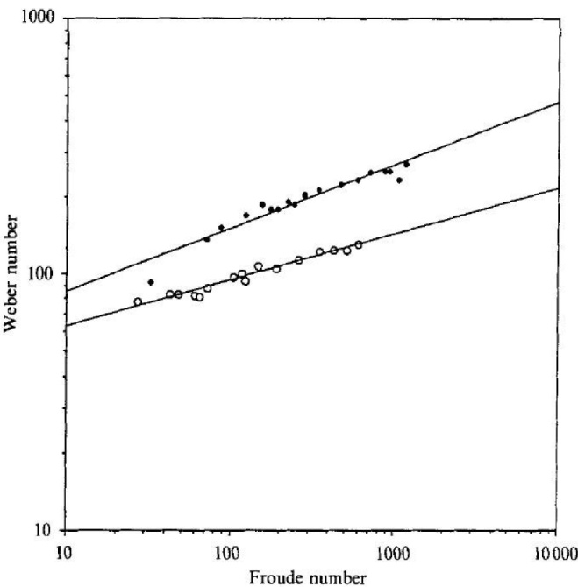
Pumphrey & Crum J. Fluid Mech, 1990
Oguz & Prosperetti J. Fluid Mech, 1990

Slide 35
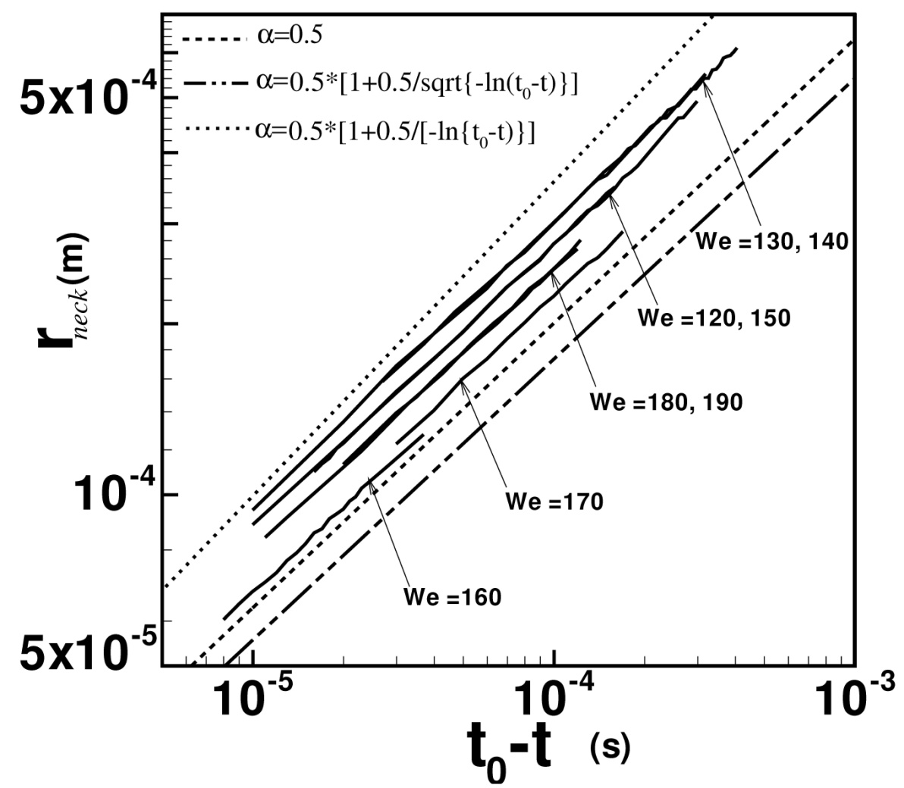
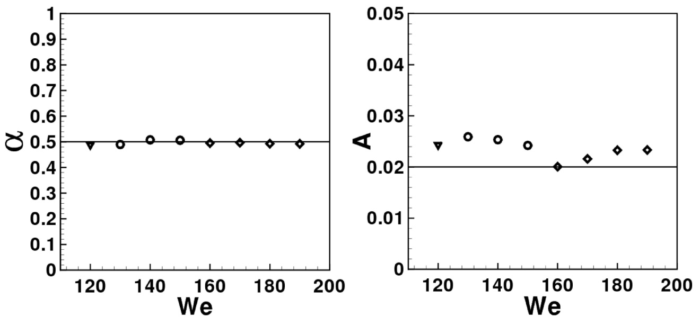
Rayleigh Plesset equation (low viscosity)
Keim et al.(2006)
Thoroddsen et al.(2007)
Gordillo et al.(2006)
Eggers et al. (2007)

Slide 36

BUBBLE ENTRAPMENT
Experiment

Slide 37

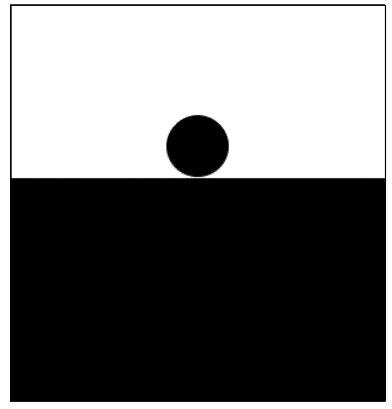

Slide 38
Large Bubble Entrapment

Slide 39
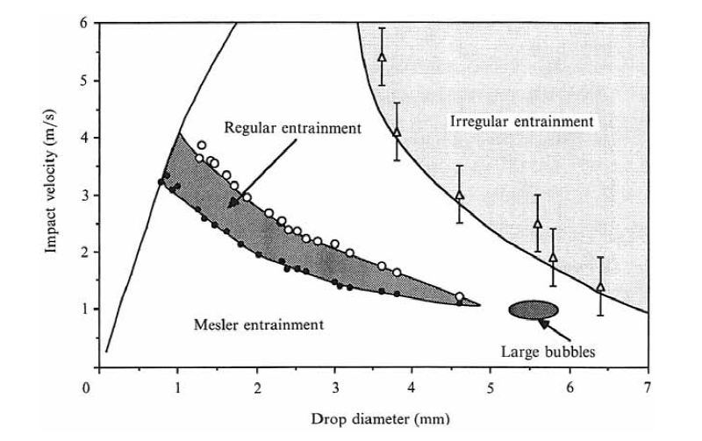
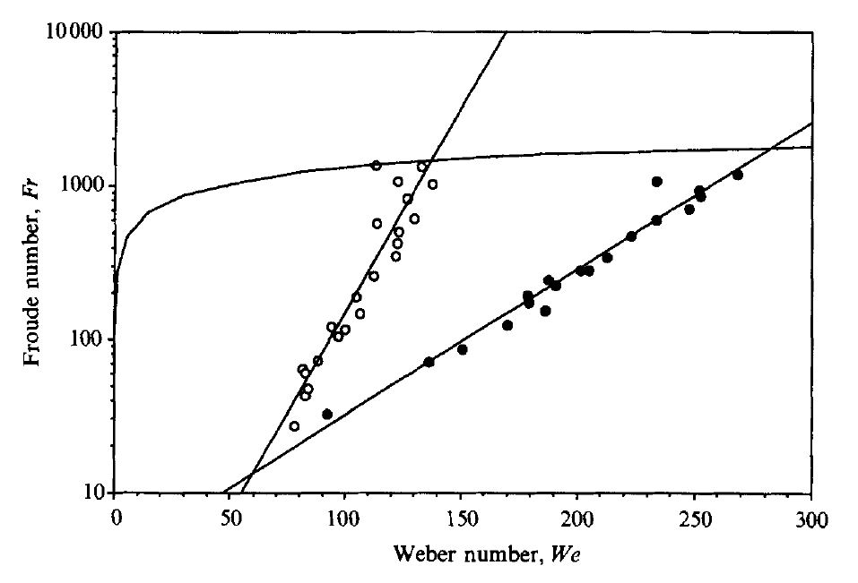
Let us revisit..
Small large bubble entrapment regime
Classification map proposed by Pumphrey and Elmore (1990)

Slide 40
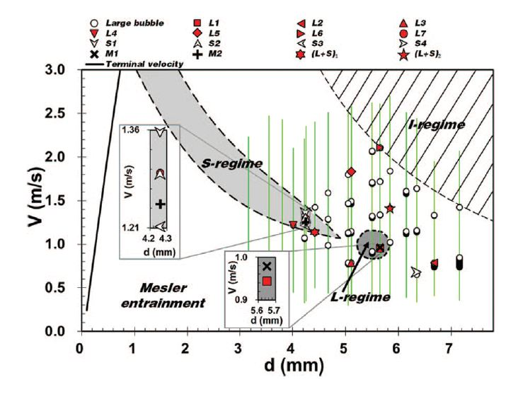
Wang et al.(2013) ‘Do we understand the bubble formation by a single drop impacting upon liquid surface? ’, Phy. Fluid , vol. 25, pp. 101702

Slide 41
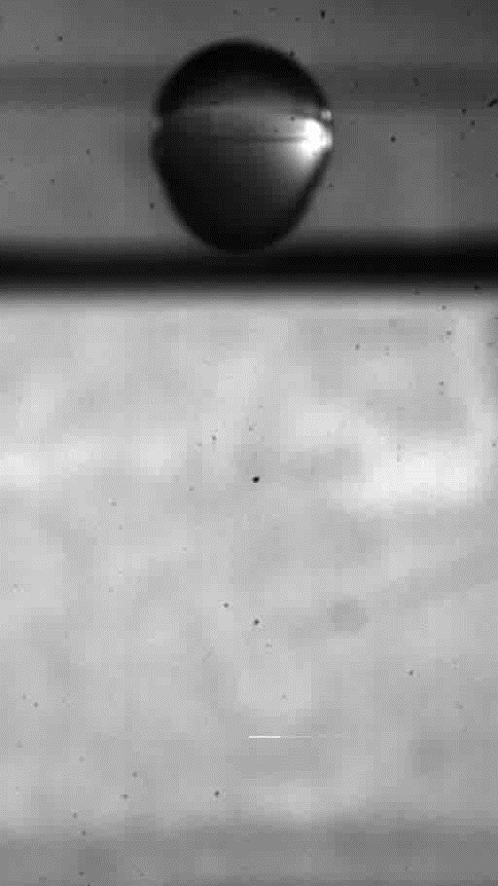
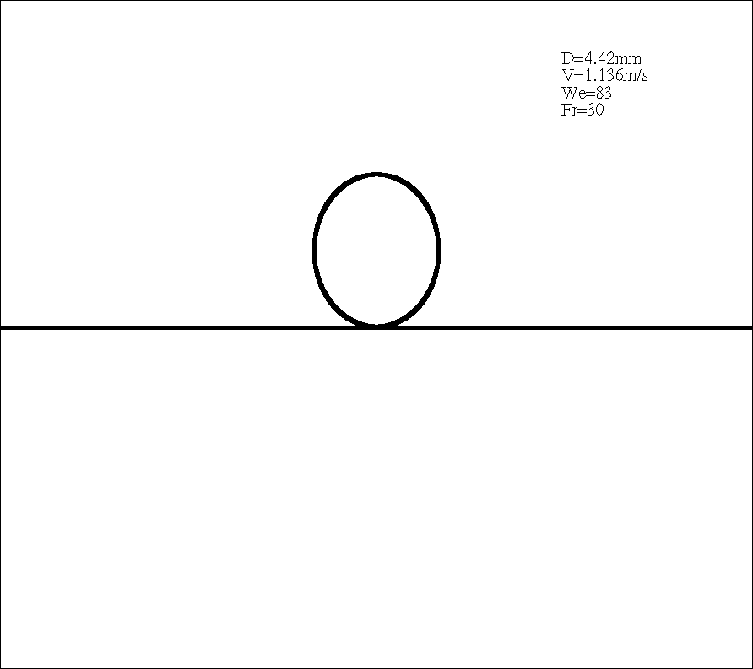
The Regime of Large Bubble Entrapment During a Single Drop Impact on a Pool
This work is published as an article entitled “The regime of large bubble entrapment during a single drop impact on a liquid pool” in the journal Physics of Fluids.

Slide 42

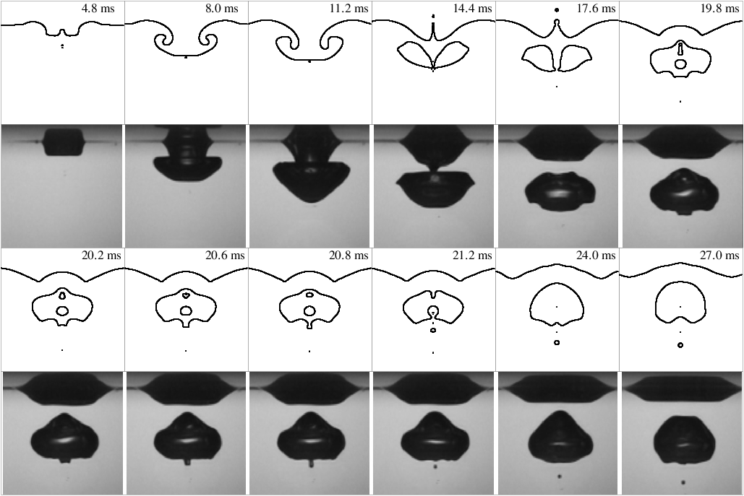

Slide 43
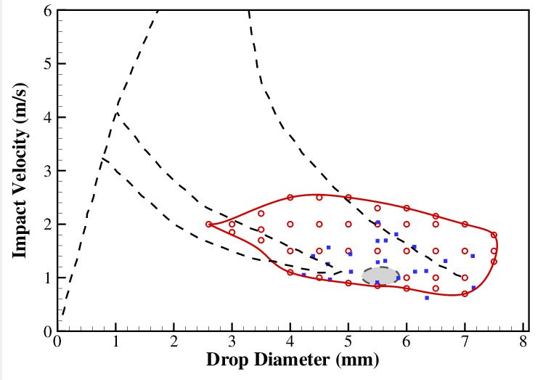
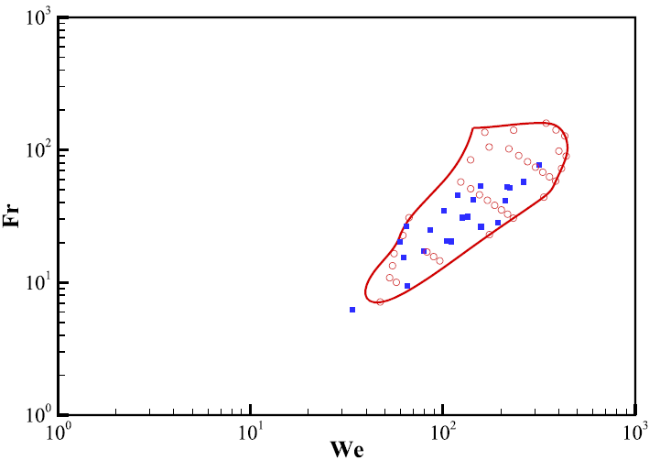
Large Bubble Entrapment
V-D map
AR = 0.7—1.4
Entrapment is observed only for prolate shaped drops. (AR = 1.21--1.4)
We-Fr map

Slide 44
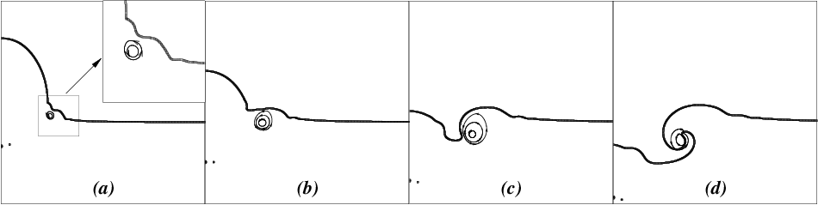
Large Bubble Entrapment
D = 4.42 mm, V = 1.136 m/s, We = 83, Fr = 30
Vortex ring originate at the interface and penetrate into the pool.
Vortex ring curls-up the liquid near the interface and forms the roll jet.
Flatter droplets produce a stronger vortex ring and self-destruct early.
For prolate shaped drops, vortex ring moves deeper into the pool before pulling on the interface. This induces a stronger vortical flow away from the interface

Slide 45
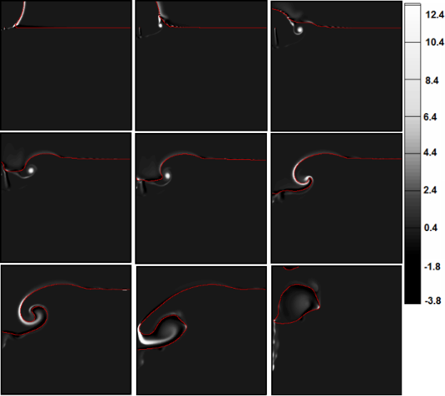
Vorticity plot

Slide 46
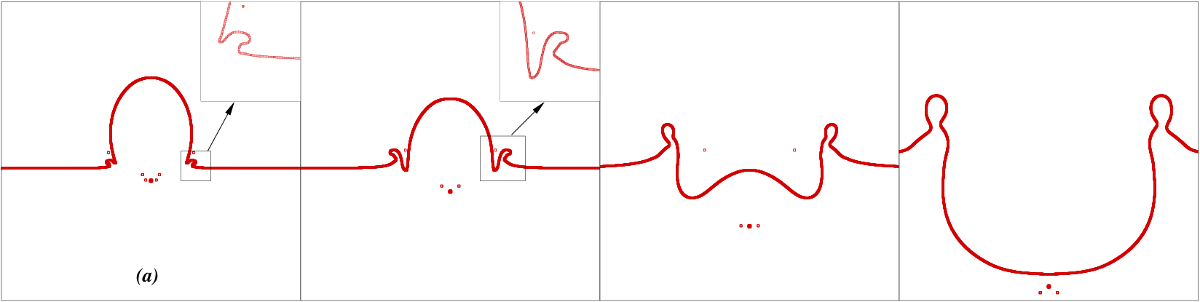
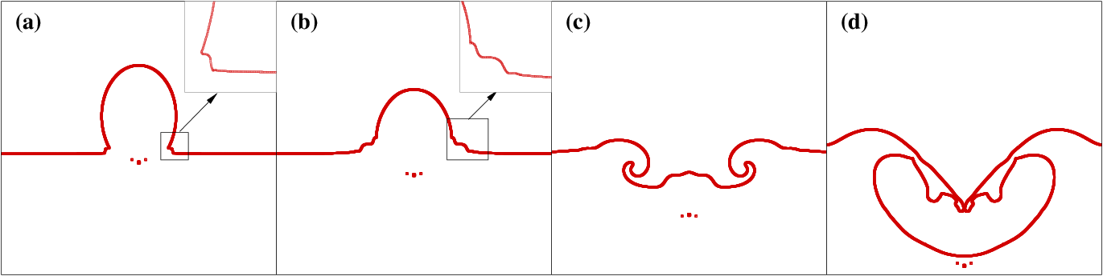
V = 2.8 m/s, We = 325, Fr = 266
V = 2.0 m/s, We = 165, Fr = 140
Formation of merged ejecta-lamella sheet prevents the vortex ring penetration.

Slide 47
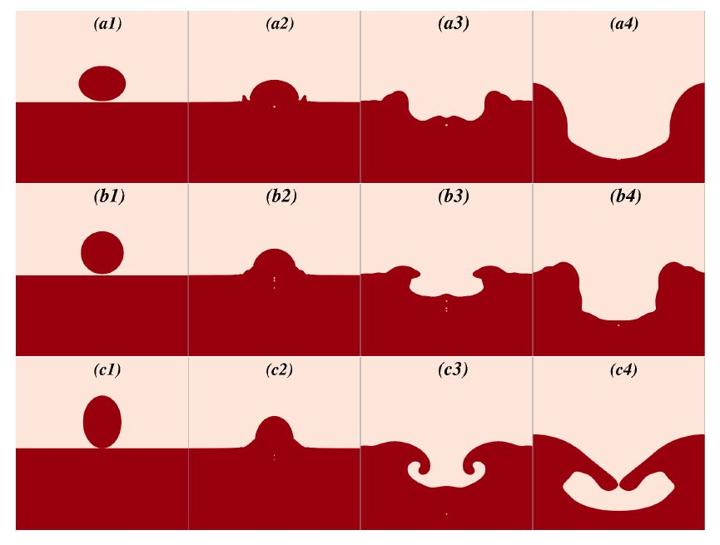
AR = 0.7
AR = 1.0
AR = 1.37
Comparison for different shapes

Slide 48
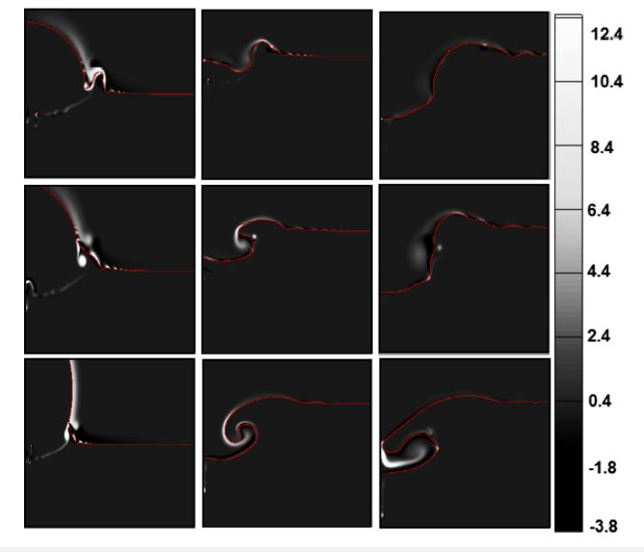
Large Bubble Entrapment
D = 5 mm, V = 1 m/s, We = 69, Fr = 20.4

Slide 49
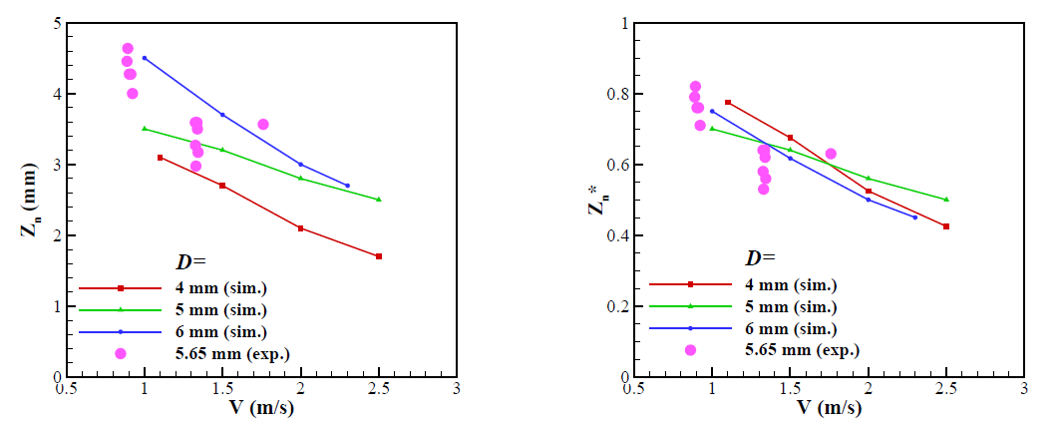
Enclosure depth decreases with increase in impact velocity
Little discrepancy between experimental and numerical results arose because of changed aspect ratio.

Slide 50
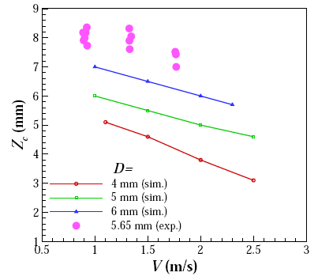
Large Bubble Entrapment
Crater depth decreases with increase in impact velocity
Higher impact velocity produces stronger vertical flow near the interface.
Vortex starts early interaction with the interface.

Slide 51
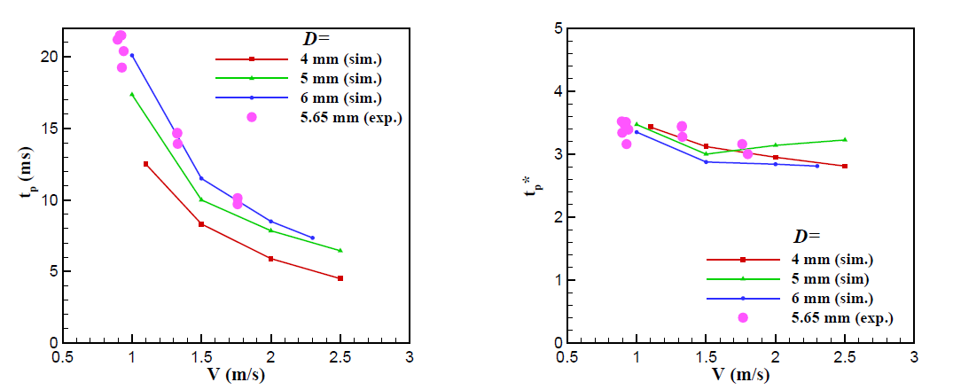
Higher impact velocity produces stronger vertical flow near the interface.
Vortex starts early interaction with the interface leading to early pinch-off.
In non-dimensional time scale, the pinch-off time is nearly constant in all the cases .

Slide 52
Conclusions
When liquid drop impacts on a liquid/ liquid or Liquid/ gas interface, for very small drops and for very large drops, the phenomena of partial coalescence do not occur.
Within the range of partial coalescence, the process can be divided into three regimes, depending on different forces, namely viscous force, surface tension force, inertia force and buoyancy force.
Partial coalescence occurs in liquid/ air medium for very low velocity and as the velocity increases complete coalescence occurs.
As the Weber number is increased, the phenomena which occurs are: partial coalescence, complete coalescence, small thick jet (with or without secondary drop), thin jet, large bubble with thin jet, small bubble with thick jet, long thick jet.
The type of phenomena depends on the direction of liquid flow during retraction stage.

Slide 53
Large bubble entrapment is observed in a wide region on the V -D map. The regime of large bubble entrapment on the V -D map and on the We-Fr map has been identied.
The shape of the drop must be prolate at the time of impact for large bubble entrapment to take place. Sometimes the large bubble is accompanied by the entrapment of a small bubble.
The vortex ring which is generated near the interface, later, pulls and curls-up the interface to form the roll jet. The roll jet merges at the central axis to entrap a large bubble inside the liquid pool. The vorticity strength must be strong enough to make the roll jet merge at the centreline, for the entrapment of large bubble.
The emergence of ejecta sheet merged with the lamella, prevents the separation and penetration of the vortex ring onto the pool, which in turn, prevents the entrapment of large bubble.
Within the large bubble entrapment regime, the enclosure depth, crater depth and pinch-off time decrease with the increase in impact velocity of the drops. The same parameters increase with the increase in size of the drops.

Slide 54

B. Ray, G. Biswas and A. Sharma, Generation of secondary droplets in coalescence of a drop at a liquid/ liquid interface, Journal of Fluid Mechanics, Vol. 655, pp. 72-104, (2010) B. Ray, G. Biswas and A. Sharma, Bubble pinch-off and scaling during liquid drop impact on liquid pool, Physics of Fluids, Vol. 24, pp. 082108-1 – 082108-11, (2012) B. Ray, G. Biswas and A. Sharma, Regimes during liquid drop impact on a liquid pool, Journal of Fluid Mechanics, Vol. 768, pp. 492-523, (2015). H. Deka, B. Ray, G. Biswas, A. Dalal, P. Tsai and A. B. Wang, The regime of large bubble entrapment during a single drop impact on a liquid pool. Physics of Fluids 29 (9),092101 (2017). Dr. Hiranya Deka (former PhD student, IIT Guwahati) Dr. Bahni Ray (former PhD student, IIT Kanpur; currently at IIT Delhi) Prof. Ashutosh Sharma (IIT Kanpur; Secretary DST) Dr. Amaresh Dalal (IIT Guwahati) Prof. Sam Welch (University of Colorado, USA; Collaborator) Prof. Stephane Zaleski (UPMC, France; Collaborator) Prof. An –Bang Wang (NTU, Taiwan, Collaborator)

